Slide 1
Wireless Telecommunication Facilities in the Public Road Right-of-Way
David Fleisch, Director, Transportation Department
Tom Temple, Senior Assistant County Counsel

Slide 2
Agenda
Background
Timeline
Ordinance Key Features
Legal Issues/Concerns
  At the time of ordinance
  Today – SB649 pending

Slide 3
Background
Increased requests for Wireless Telecommunications Facilities–Public Right-of-Way (WTF–PROW) led to BOS direction to create an ordinance
In drafting the WTF Ordinance, reviewed existing ordinances, considered federal and state law, and incorporated feedback from wireless providers, the public and County staff
Lengthy process of review and update
Carefully considered all input from public, wireless companies, and staff
Notes:
Between 2006 and 2011 one permit request for WTF in the ROW
Between Oct 2011 and Feb 2012 - 6 permit requests
WTF requests are ministerial, non-discretionary permits
Input:
Municipal Advisory Councils/Property Owners Associations
Wireless Companies: Verizon, AT&T, Crown Castle
Southern California Gas
Ventura County Planning Department

Slide 4
Timeline
February 7, 2012 – BOS provided direction to draft a WTF Ordinance
November, 2012 – 1st draft of the Ordinance was completed
April 7, 2013 – 1st public hearing scheduled
May 7, 2013 – 1st presentation to BOS
June 25 - Sept 24 – Discussions with wireless providers and County staff
August 12, 2013 – Meeting with representatives from the wireless companies to review all requested changes
October 28, 2013 – Ordinance Approved by BOS

Slide 5
Key Features
Installation type preference
  Small-cell installation
  Cluster (collocation) installation
    Residential
    Nonresidential
  Single
  New installation
Levels of review – Based upon installation type and location
  Basic
  Intermediate
  Full

Slide 6
Matrix of Requirements
 | Traffic control plan | Scaled site plan | Fully dimensioned plan | Visual impact analysis | RFR & EMF report |  | Certificate of insurance | Licenses/registration/ certification from FCC & CPUC |  | Building /other permits | Authorization to hire expert | Alternative locations analysis | Evidence of infeasibility as needed | Additional information as needed
New Installation | ▪ | ▪ | ▪ | ▪ | ▪ | ▪ |  |  | ▪ | ▪ | ▪ | ▪ | ▪ | ▪
Small-Cell Installation | ▪ |  |  |  |  | ▪ |  |  | ▪ | ▪ |  | ▪ | ▪ | ▪
Collocation
With substantial increase in size | ▪ | ▪ | ▪ | ▪ | ▪ | ▪ |  |  | ▪ | ▪ | ▪ | ▪ | ▪ | ▪
Without substantial increase in size
Residential area | ▪ |  |  | ▪ |  | ▪ |  |  | ▪ | ▪ | ▪ | ▪ | ▪ | ▪
Non-residential area | ▪ |  |  |  |  | ▪ |  |  | ▪ | ▪ |  | ▪ | ▪ | ▪
Basic
Intermediate
Full

Slide 7
Key Features (continued)
Height
  < 5 feet of average height of existing utility poles
  < 5 feet over height of existing County traffic pole standard
  Specific limits per the area-specific plan (Ojai, Thousand Oaks)
  Exception to height limits:
    If alternative location in the ROW is unavailable or not technically feasible
    Another regulation requires greater height
Appeal of decision to grant or deny a permit
  To the Road Commissioner (Public Works Agency Director)
  Must be filed within 10 days
  Must demonstrate how decision does not comply with ordinance
  Who can file:
    Applicant
    Property owner, must be in the notification zone

Slide 8
Key Features (continued)
Public notification requirements
  Notification Zone – 300 ft wide by 500 ft long
  Preapproval notification – 30-day notification period
    New installation
    Collocation in a residential area
    Collocation with substantial increase in size
    Coastal zone – not required
  Preconstruction notification for all – two weeks prior
    Written notification to community
    Posted signage 3′ x 4′

Slide 9
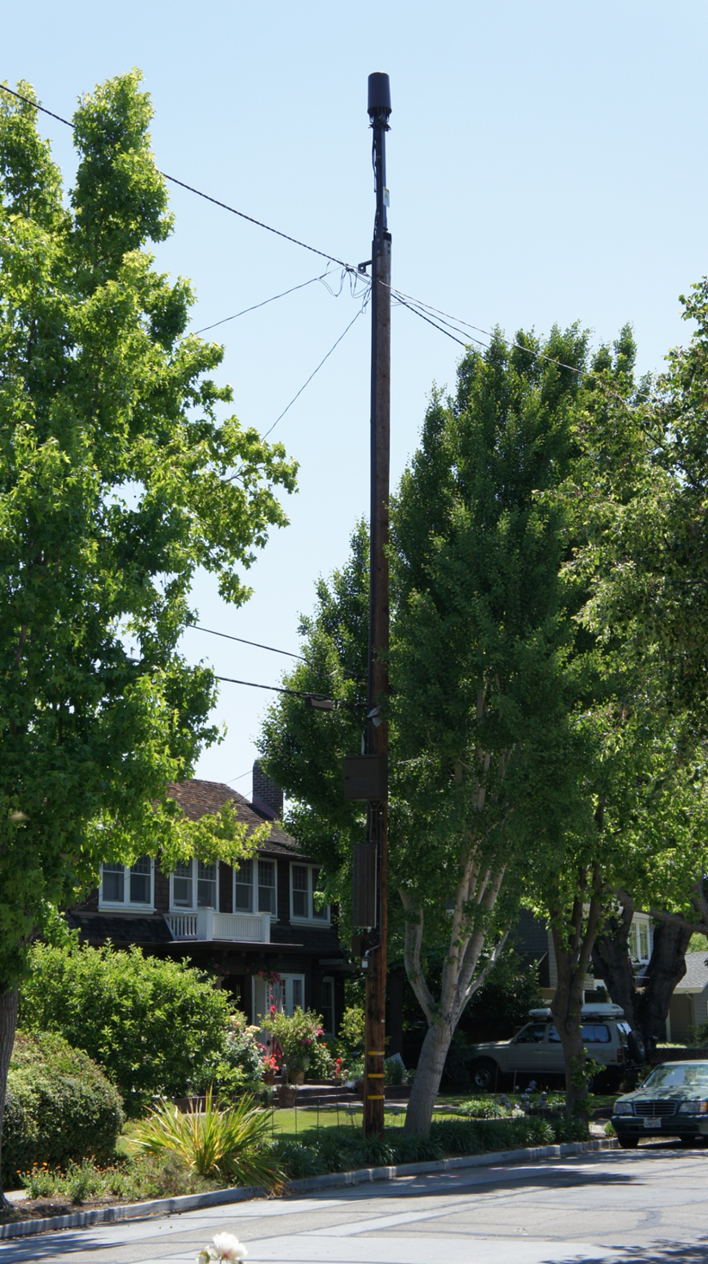
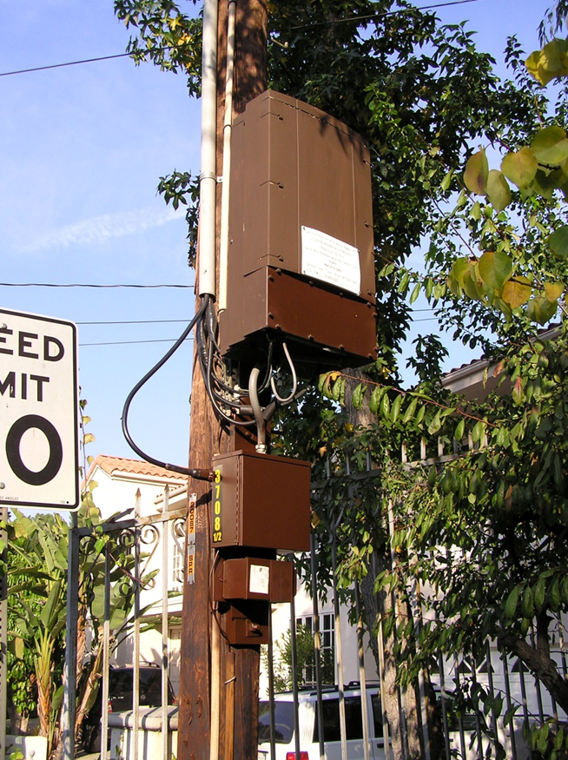
Examples
Pole top
extension
Small cell
installation

Slide 10
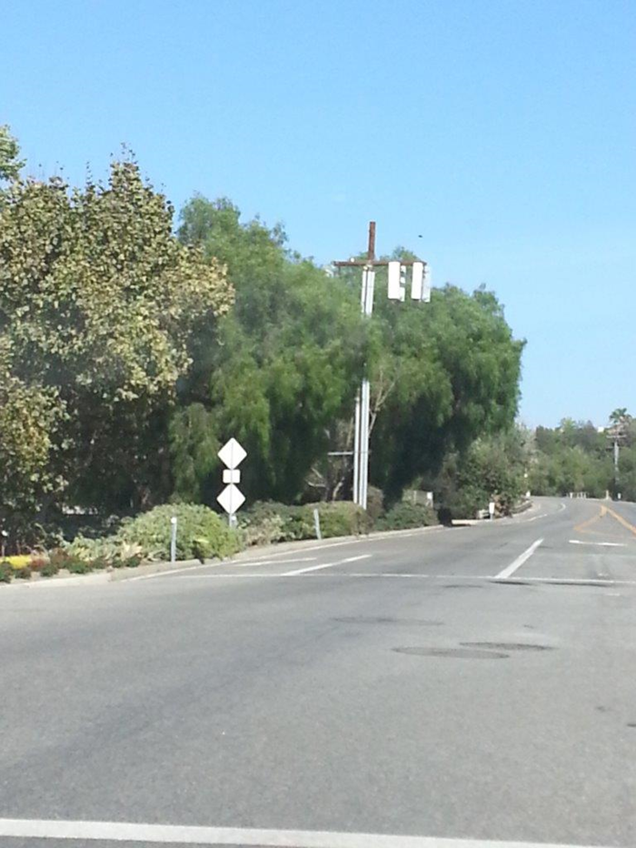
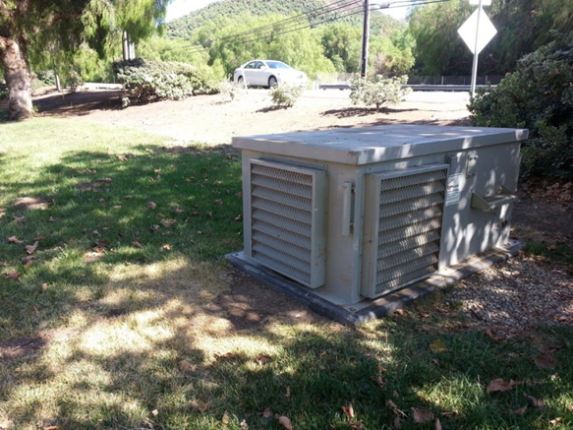
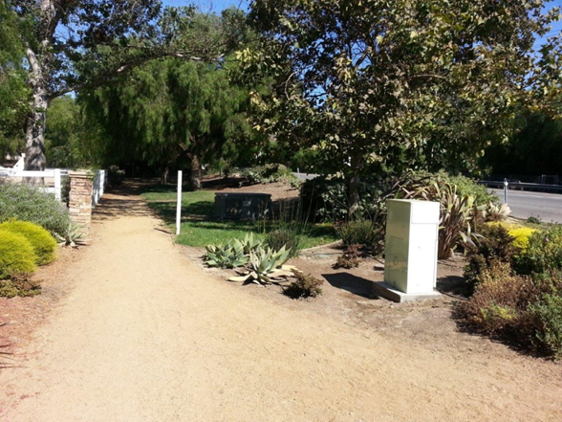
Installation with Vault

Slide 11
Legal Issues/Concerns
Are we allowed to regulate WTFs in the ROW?
  Yes, but …

Slide 12
Yes: Permissible Regulation of WTF in ROW
Public Utilities Code § 7901: Telephone company cannot “incommode” public use of road (and “incommode” includes aesthetic considerations)
Public Utilities Code § 7901.1: Reasonable control over time, place, and manner of access for construction, maintenance, etc.
Streets & Highways Code § 1460: Road Commissioner may issue encroachment permits
47 U.S.C. § 253(c): Local authority to manage public rights-of-way
47 U.S.C. § 332(c)(7): Local authority over “personal wireless service facilities”

Slide 13
But: Restrictions on Regulation of WTF in ROW
47 U.S.C. § 332(c)(7)(B)(iv): Cannot regulate effects of RF emissions (FCC exclusive jurisdiction)
47 U.S.C. § 332(c)(7)(B)(i)(II): Cannot prohibit or effectively prohibit provision of personal wireless services
47 U.S.C. § 1455(a) (aka “section 6409(a)”): Must approve collocation, removal, or replacement of WTF on an existing wireless tower or base station if modification does not “substantially change the physical dimensions”
SB 649: Pending legislation

Slide 14
47 U.S.C. § 1455(a) (“section 6409(a)”)
In 2014, FCC interpreted section 6409’s language (Report and Order, October 21, 2014):
  “Wireless tower”: Structure whose sole or primary purpose is to support WTF equipment (even if no WTF equipment on it)
  “Base station”: Equipment plus structure (if WTF equipment on it already)
  “Collocation”: Includes first placement of equipment on a tower (but not on a base station)
  Modification includes structural enhancements to the tower or base station
  “Substantially change”: Specific height, width, and other details specified
  60-day “shot clock” for processing application
  Section 6409 does not apply to property owned by local government

Slide 15
SB 649: Streamlining Permits for Small Cells
Bill passed by Senate but amended and currently pending in Assembly Appropriations Committee (as of August 22, 2017)
Applies to “small cell” WTF, including those in ROW
Allows encroachment permit, including various conditions (including some fees)
Prohibits requirement for in-kind contributions, submission of excessive information, and limitations on routine maintenance
Completely exempts “micro wireless facilities” suspended from cables
Prohibits refusal to lease or license “vertical infrastructure”

Slide 16
Questions?

