Slide 1
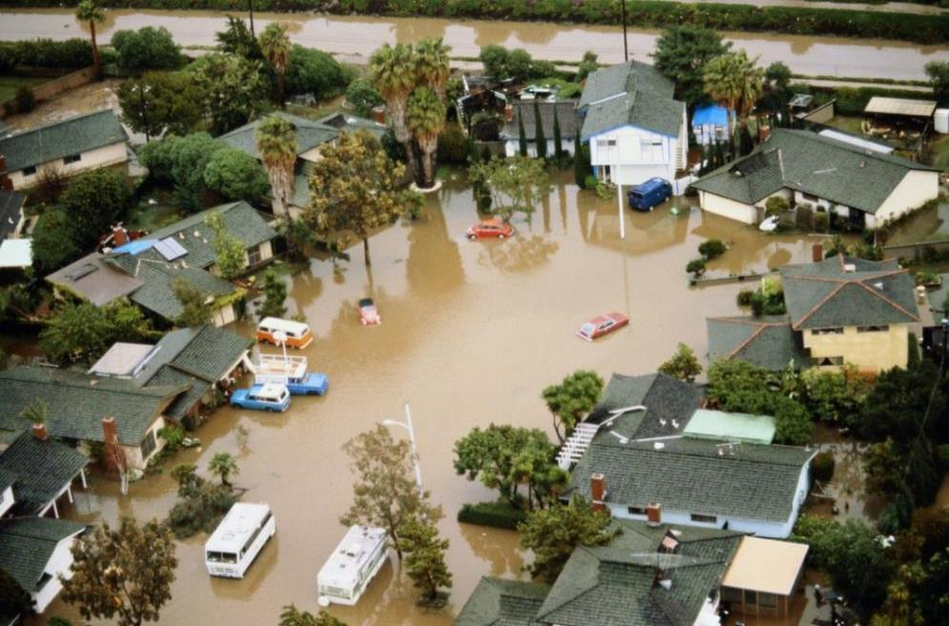
CA Dept. of Water Resources Flood Management Activities Update
County Engineers’ Association of California Flood Control & Water Resources Policy Committee
August 18, 2022
Image: Los Angeles Magazine, Aug. 14, 2022 photo from Huntington Beach floods of 1983.
Michael Mierzwa, P.E., State Floodplain Manager
CA Dept. of Water Resources, Division of Flood Management

Slide 2
CA Flood Preparedness Week
Oct. 22 – 29, 2022
11th annual event
Local, State, and Federal agencies join together to inform Californians on the types of flooding and what people can do to protect themselves
https://sites.google.com/view/cfpw/home
Contacts: Nikki Blomquist – Nikki.Blomquist@water.ca.gov Jason Ince – Jason.Ince@water.ca.gov

Slide 3
2022 CA Preseason Flood Coordination Meetings

Slide 4
DWR’s Floodplain Management Financial Assistance Programs
DWR Flood Risk Reduction Grant Program | Status | State Plan of Flood Control | Central Valley | Statewide | Current Fund Source
Statewide Flood Control Subventions Program | Ongoing |  |  | ✓ | Proposition 1E
Local Levee Assistance Program | Legacy / Closed |  |  | ✓ | Proposition 1E
Small Community Flood Risk Reduction Program* | Funding Committed | ✓ |  |  | Proposition 1E
Regional Flood Management Planning | Ongoing | ✓ |  |  | Propositions 1E & 68
Central Valley Tributaries Program | Ongoing |  | ✓ |  | Proposition 1
Coastal Flood Risk Reduction Protection Program* | Funding Committed |  |  | ✓ | Propositions 1 & 68
Floodplain Management Protection and Risk Awareness Program | Pending | ✓ | ✓ | ✓ | Proposition 68
Conveyance Subsidence Program | Funding Committed |  | ✓ |  | General Fund Earmark
NOTE: These (*) programs may have future competitive funding rounds in the next several years.

Slide 5
Floodplain Management Protection & Risk Awareness Program Projects vs. Planning and Monitoring

Slide 6
FEMA High Hazard Potential Dam Grant Program
Established in 2016 by Water Infrastructure Improvements for the Nation Act (WIIN)
Previous funding in 2019, 2020, and 2021
Funding increasing each year (FY2022 is $22M nationwide)
DWR is the state applicant / administrator
Eligible sub-applications for FY2022 were submitted to FEMA in July 2022
FEMA maximum funding for California will be determined in Sept. 2022
DWR will submit recommended funding awards to FEMA around Dec. 2022

Slide 7
HHPD Eligibility
State dam safety program
Classified as a high hazard (or greater) dam
Have an Emergency Action Plan (EAP)
Be located within a jurisdiction with an approved Hazard Mitigation Plan
Fail to meet minimum dam safety standards
Activities can including:
Repair
Removal
Structural / non-structural rehabilitation
Contact:
Levi Warr – Levi.Warr@water.ca.gov

Slide 8
FEMA Hazard Mitigation Assistance: The Big Three
HMA Program | Pre- Disaster | Post- Disaster | Authorities & Requirements
Building Resilient Infrastructure and Communities (BRIC) | ✓ |  | Stafford Act (1988) / Hazard Mitigation Plan Activity
Flood Mitigation Assistance (FMA) Grant Program | ✓ |  | National Flood Insurance Program (1968) / Must be NFIP Community / Must be HMP Flood Activity
Hazard Mitigation Grant Program (HMGP) |  | ✓ | Stafford Act (1988) / Hazard Mitigation Plan Activity
NOTE: FEMA has other specialty programs too, including its High Hazard Potential Dam (HHPD) Program.

Slide 9
FY22 BRIC Information
$2.295B nationwide competitive grant program
Focus on nature-based-solutions and disadvantaged communities
Enforcement of building codes included
Multiple benefit approaches encouraged
Cal OES the lead, aka “applicant”
Cal OES / DWR happy to consult with local subapplicants
Subapplicant must have an approved Hazard Mitigation Plan
Sept. 16, 2022 Notice of Interest due
Dec. 2, 2022 Subapplication due

Slide 10
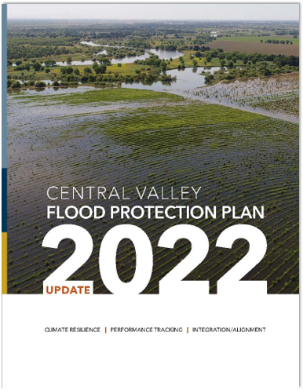
Central Valley Flood Protection Plan
State’s strategic blueprint for Central Valley flood risk management
State Systemwide Investment Approach, guides State flood management in areas protected by State Plan of Flood Control
2022 CVFPP is second update of the Plan
Fulfills requirements of the Central Valley Flood Protection Act of 2008
Notes:
The Central Valley Flood Protection Plan is a strategic blueprint for Central Valley flood risk management that considers these realities.
The CVFPP describes a programmatic vision for improving flood risk management throughout the Central Valley over the next 30 years. The foundation of the CVFPP is the State Systemwide Investment Approach, which guides how the State will invest in flood management in areas protected by the State Plan of Flood Control.
The Public Draft 2022 CVFPP Update is the second update to the CVFPP and fulfills the requirements of the Central Valley Flood Protection Act of 2008.
The CVFPP also supports the Water Resilience Portfolio, the Administration’s blueprint for equipping California to cope with extreme droughts, floods, and other water resources challenges. The CVFPP also aligns with the California Water Plan, which is the State’s strategic plan for sustainably and equitably managing and developing water resources for current and future generations.

Slide 11
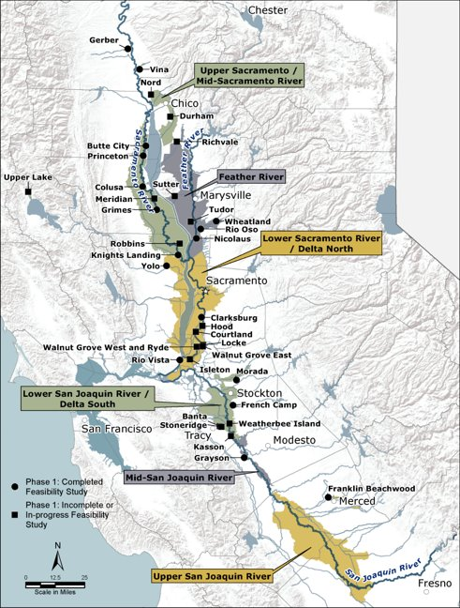
2022 CVFPP Update: Three Primary Themes
Build flood system climate resiliency
Increase accountability and adaptation through performance tracking
Align with other State water management planning efforts
Notes:
The 2022 Update to the Plan is built around three guiding themes:
Building flood system climate resiliency;
Increasing accountability through performance tracking and transparency; and
Aligning strategically with other State water management planning efforts.
The 2022 CVFPP Update also acknowledges how equity considerations are inherent in all three themes. For example:
Community resilience in preparing for, responding to, coping with, recovering from, and adapting to floods and the impacts of climate change;
Tracking outcomes for vulnerable communities; and
Aligning with other State programs supporting equity.

Slide 12
Components of the Public Draft 2022 CVFPP Update
Chapter 2
CVFPP Implementation Progress
Chapter 3
Risks, Priority Actions, and Intended Outcomes
Chapter 4
Investment Strategy and Imperative to Act
Chapter 1
Updating the CVFPP
Call to Action Infographic
Forewords
DWR Director
CVFPB President
6 Regional Overviews
Will be completed with CVFPB during Public process
Three Appendices have been released​
CVFPP Background​
Legislative Reference and Reader’s Guide​
CVFPP Supplemental Recommendations
Notes:
The 2022 CVFPP Update is broken into four chapters:
Chapter 1: Information about the process of updating the CVFPP
Chapter 2: The CVFPP implementation process and what has been completed
Chapter 3: What implementation is in-progress and what is planned, as well as updated risk priorities, portfolios and outcomes
Chapter 4: What the plan is for moving forward, including capital and ongoing investment estimates
Two-page regional overviews for the 6 Regional Flood Management Planning regions are included in the 2022 CVFPP Update as well. The planning team has worked with the regions over the past few months to develop these two-page regional spotlights. RFMPs continue to focus on locally led
planning activities to support effective CVFPP implementation in each region.
A Call to Action upfront piece and the letters from the DWR Director and the CVFPB President will be developed closer to the Board’s adoption of the 2022 Plan. We intended to work on the call to action with the CVFPB staff as we work through the Public process.

Slide 13
A Shared Responsibility to Act
We must:
Work together to increase public awareness and build support for flood risk management investments
Act swiftly to implement innovative flood management strategies
Invest boldly over the next 30 years
Build and leverage each partners' unique capacity for funding and advocacy
Protect the Central Valley’s most vulnerable communities
Notes:
The 2022 CVFPP Update highlights that while it is costly to prepare for and help prevent flood related disasters, it is many times more costly to respond to, and recover from a flood after it occurs.
The entire flood management community—including you in the engineering sphere, as well as businesses and other organizations that have not previously had an active interest in flood management—must work together to transform the recommendations, actions, and policies within the CVFPP from anecdotes and pilot projects into standard operating procedures. This impacts all of us and we share the responsibility to act.
We must:
Work together to build public support for flood risk management investments. The CVFPP is not funded, which means we need to build support for these efforts in order to secure state and federal financing. We need your help and support to make that happen.
Act swiftly to implement innovative cross-sector flood management strategies. For example, we must value a resilient flood system’s contribution to broader policy challenges such as groundwater management and ecosystem stewardship.
We must:
Invest boldly over the next 30 years – including investing in partnerships with local, State, and federal agencies – as well as with landowners and NGOS.
We must:
Built institutional capacity, move projects forward, and leverage each flood system partner’s unique capacity for financing and advocacy.
And we must:
Protect the Central Valley’s most vulnerable communities, acknowledging and correcting historic inequalities.

Slide 14
State Funded Research
DRAFT
Image: Example of GIS analysis of FEMA Open Source Data from Ryan Miller’s PhD work at UC Davis. This manuscript is still in draft, but Miller has been working with DWR FPM staff.

Slide 15
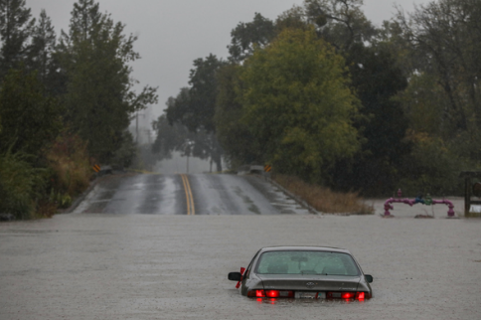
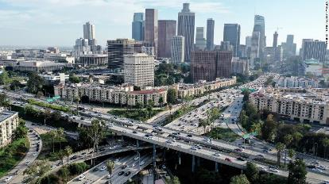
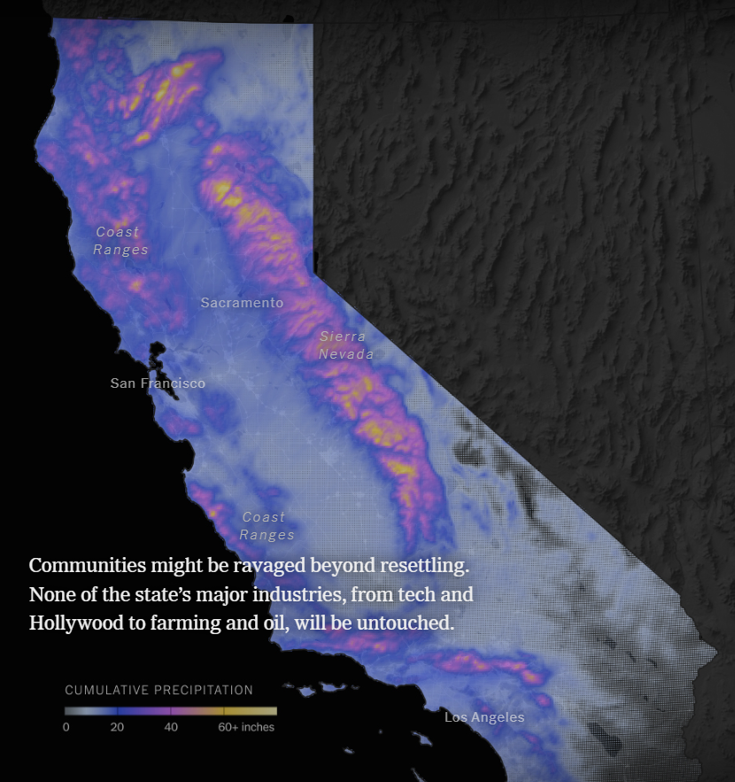
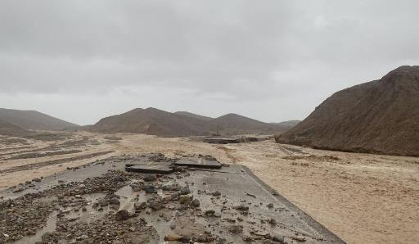
ARkStorm 2.0 Key Messaging
2x more likely to experience extreme events bringing 2x – 4x as much precipitation by 2100
Storm scenario accounted for climate change signals (ocean and atmospheric temperature) on historic extreme precipitation events
Exposure estimate ($1T in impacts) is a scaled (escalated for growth) estimate based on FEMA Hazus Level 1 data from around 2010
DWR has started scoping for downscaling ARkStorm into an on the ground statewide flood risk assessment – we will need your input
Scientific American (Aug. 16, 2022)
CNN (Aug. 14, 2022)
Washington Times (Aug. 13, 2022)
New York Times (Aug. 12, 2022)

Slide 16
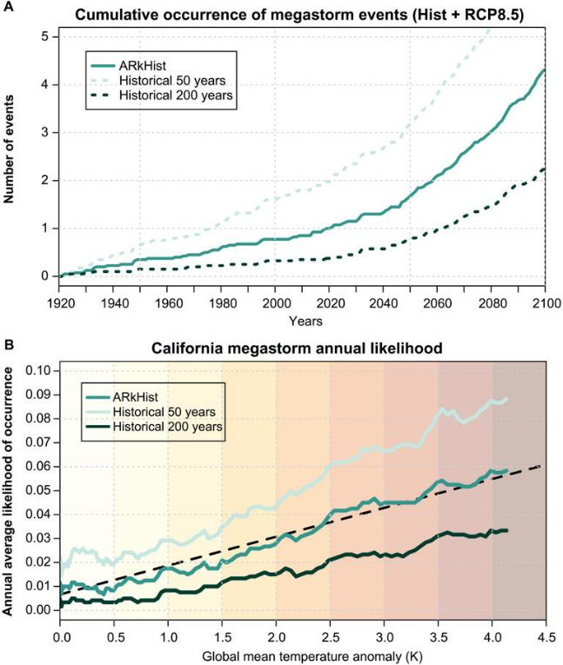
ARkStorm 2.0 Key Messaging
2x more likely to experience extreme events bringing 2x – 4x as much precipitation by 2100
Storm scenario accounted for climate change signals (ocean and atmospheric temperature) on historic extreme precipitation events
Exposure estimate ($1T in impacts) is a scaled (escalated for growth) estimate based on FEMA Hazus Level 1 data from around 2010
DWR has started scoping for downscaling ARkStorm into an on the ground statewide flood risk assessment – we will need your input
CBS News (Aug. 15, 2022): Dr. Swain’s ARkStorm 2.0 data.

Slide 17
Recap
Flood season is approaching, so we should collectively work to engage the public and media to raise awareness
Most of DWR’s current financial assistance programs are focusing on implementation
Congress has significantly increased funding for FEMA’s financial assistance programs, focusing on pre-disaster mitigation at community scales (i.e. BRIC)
The State has a rolling 5-year investment plan for the Central Valley known as the Central Valley Flood Protection Plan (due for adoption in Oct. 2022)
DWR has been working with the academic community to better understand both statewide flood risk (ARkStorm) and our collective approaches to mitigating this risk
ARkStorm 2.0 represents a challenge to our existing response abilities and an opportunity for us to prepare for climate change
Michael Mierzwa – Michael.Mierzwa@water.ca.gov

