Slide 1
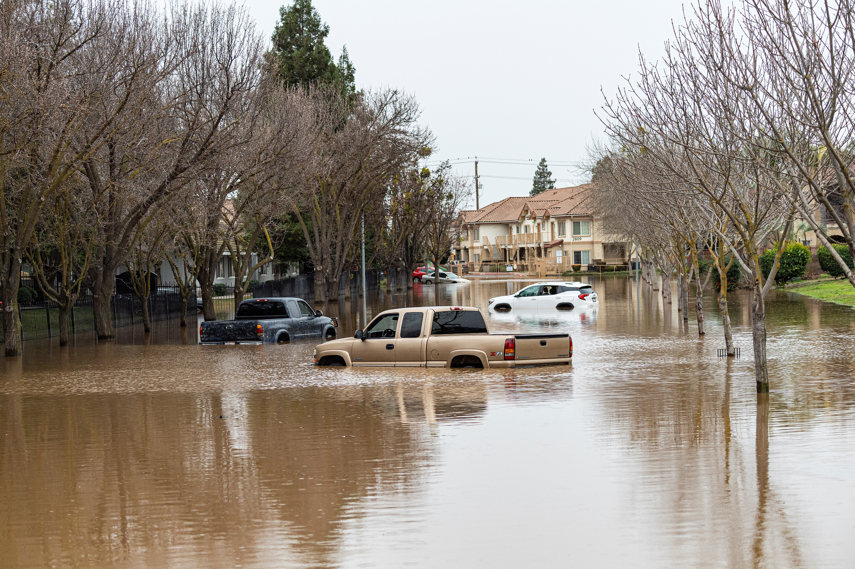
CEAC Flood & Water Infrastructure Committee
Universal City, CA
March 8, 2023
Sami Nall, P.E., CFM
Sami.Nall@water.ca.gov
CA Dept. of Water Resources, Division of Flood Management

Slide 2
DWR’s Floodplain Management Financial Assistance Programs
DWR Flood Risk Reduction Grant Program | Status | State Plan of Flood Control | Central Valley | Statewide | Current Fund Source
Statewide Flood Control Subventions Program | Ongoing |  |  | ✓ | Propositions 1E & 84
Local Levee Assistance Program | Legacy / Closed |  |  | ✓ | Proposition 1E
Small Community Flood Risk Reduction Program* | Funding Committed | ✓ |  |  | Proposition 1E
Regional Flood Management Planning | Ongoing | ✓ |  |  | Propositions 1E & 68
Central Valley Tributaries Program* | Ongoing |  | ✓ |  | Proposition 1
Coastal Flood Risk Reduction Protection Program* | Funding Committed |  |  | ✓ | Propositions 1 & 68
Floodplain Management Protection and Risk Awareness Program* | Funding Committed | ✓ | ✓ | ✓ | Proposition 68
Conveyance Subsidence Program | Funding Committed |  | ✓ |  | General Fund Earmark
NOTE: These (*) programs may have future competitive funding rounds in the next several years.

Slide 3
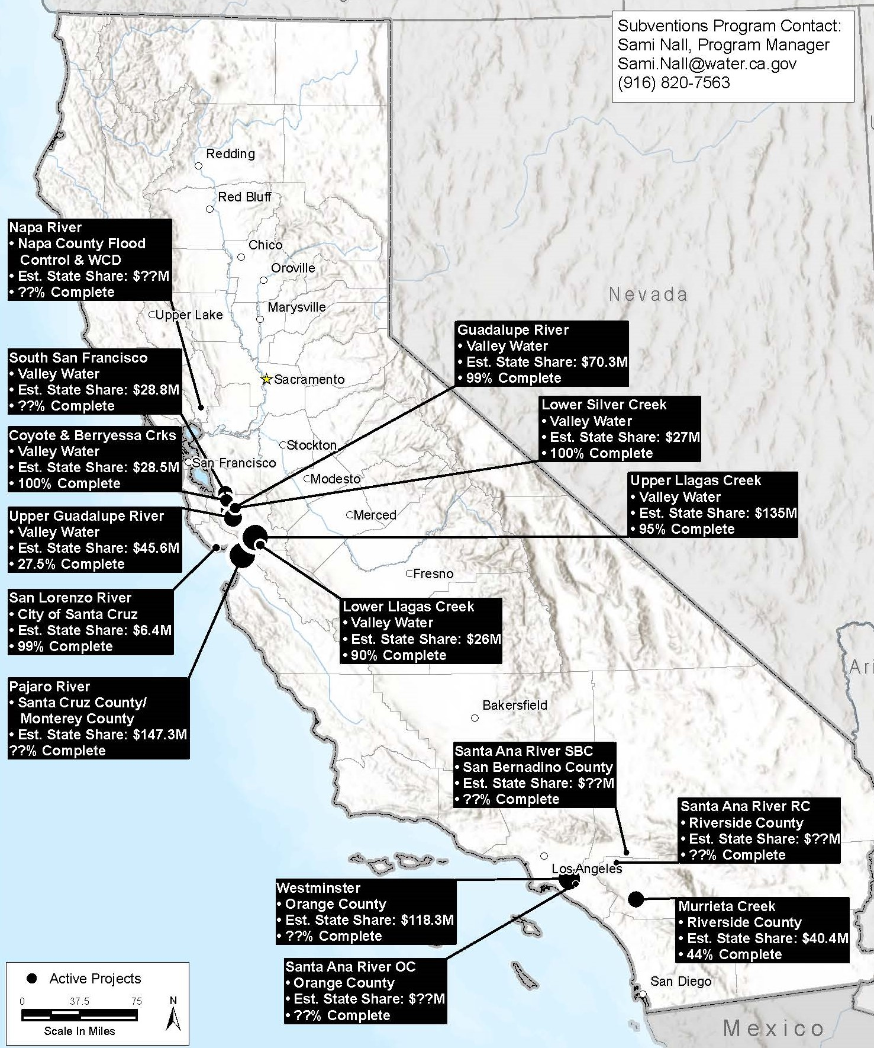
Flood Control Subventions Program
USACE/Local Agency Projects
Identified within the Water Code
15 Current/Active Projects

Slide 4
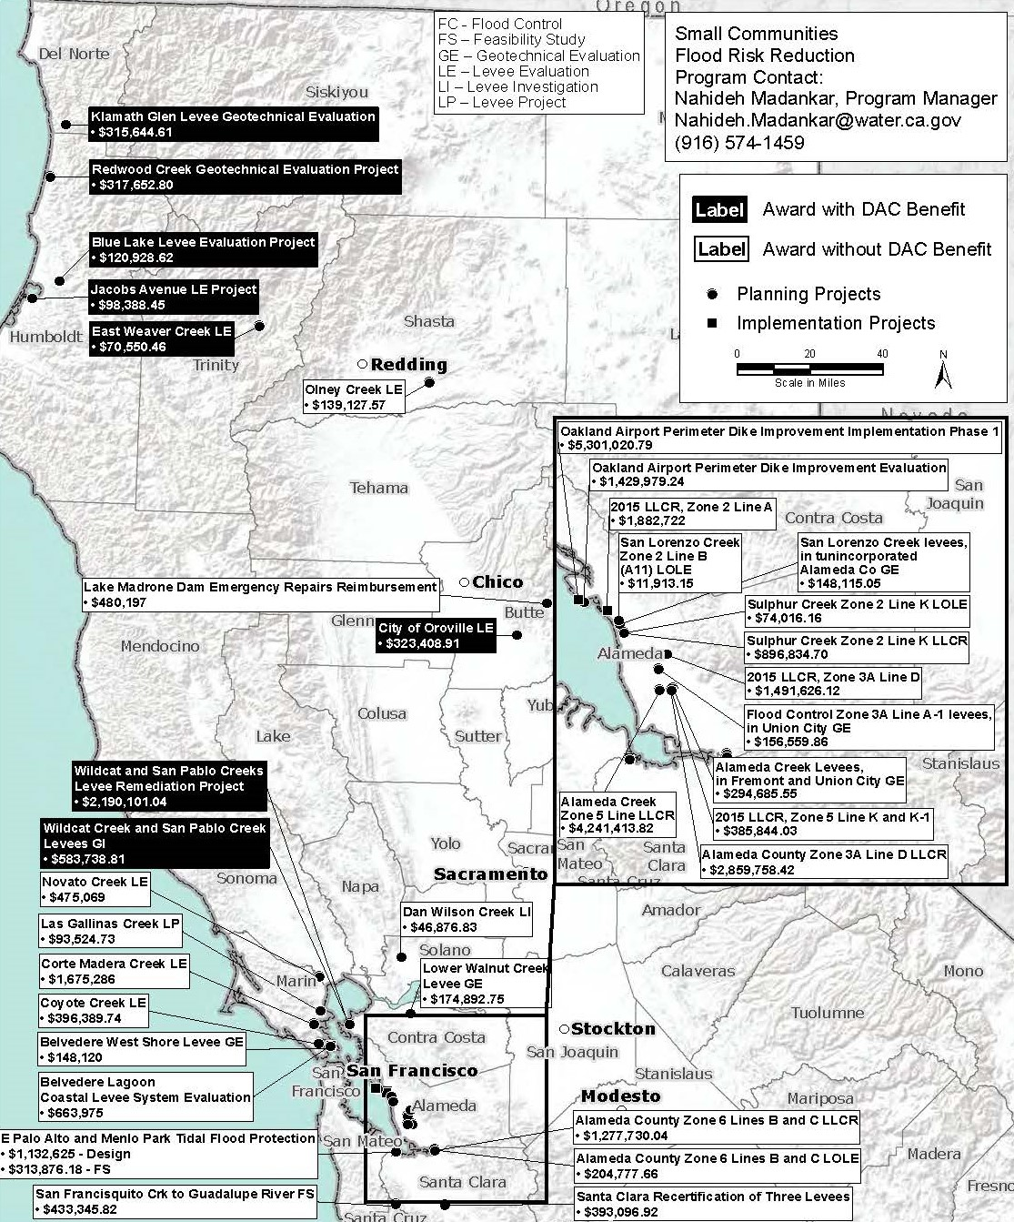
Local Levee Assistance Program
$84 Million, 3 Rounds
63 awards, 7 still ongoing

Slide 5
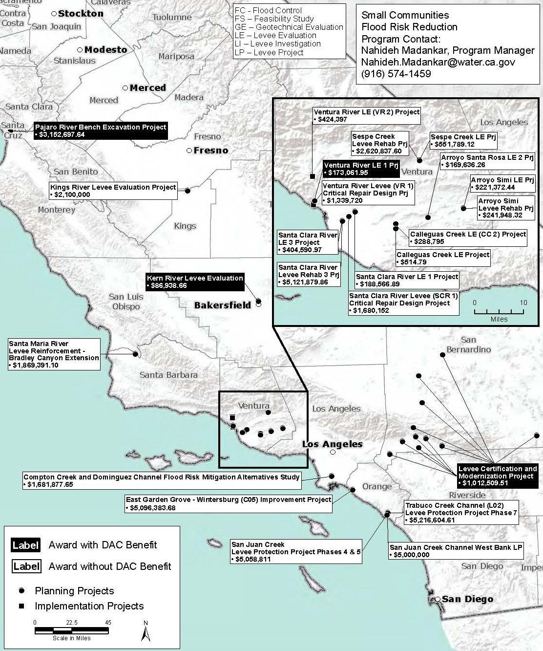
Local Levee Assistance Program
$84 Million, 3 Rounds
63 awards, 7 still ongoing

Slide 6
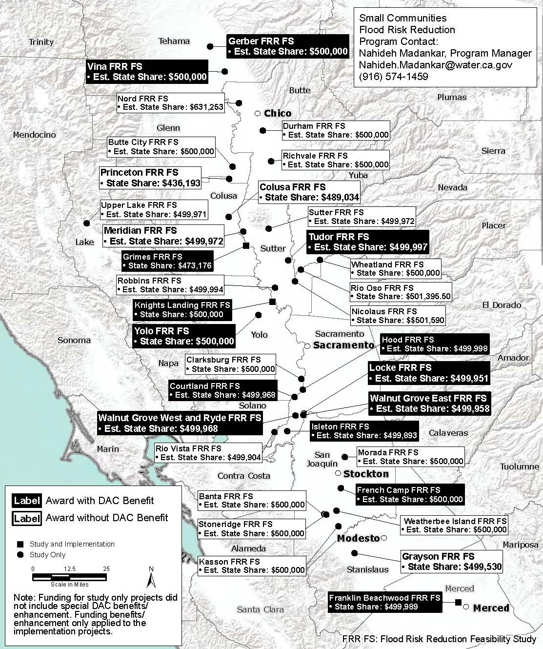
Small Communities Flood Risk Reduction Program
$50 Million, 2 Rounds
32 Planning & Monitoring Projects
3 Implementation Projects

Slide 7
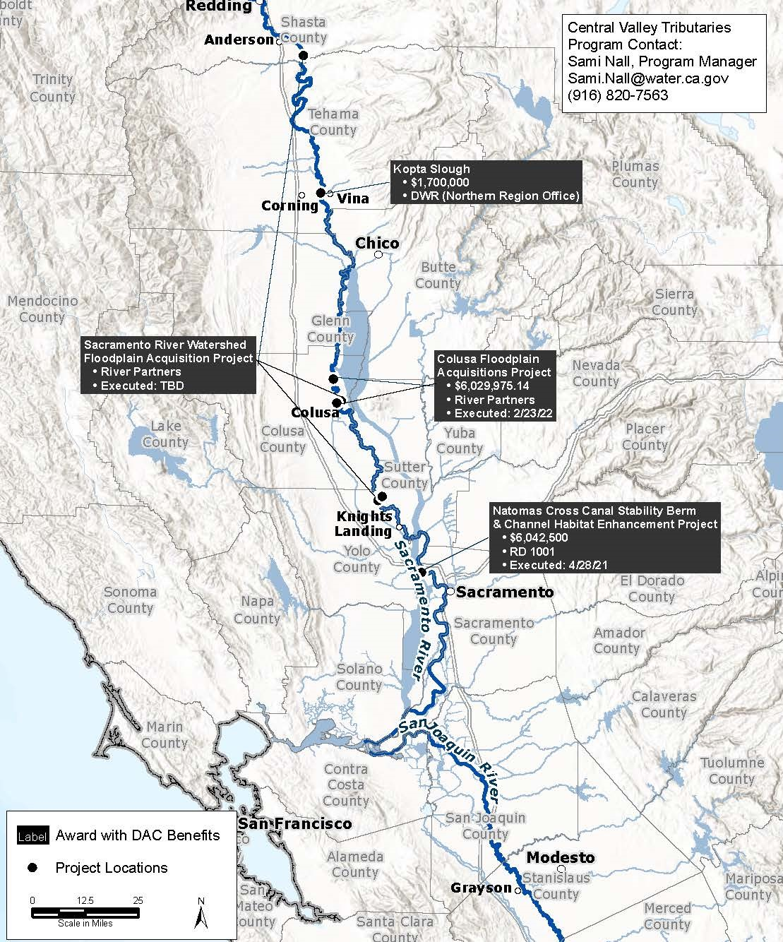
Central Valley Tributaries Program
$38 Million
3 Implementation Projects
1 Planning & Monitoring Project

Slide 8
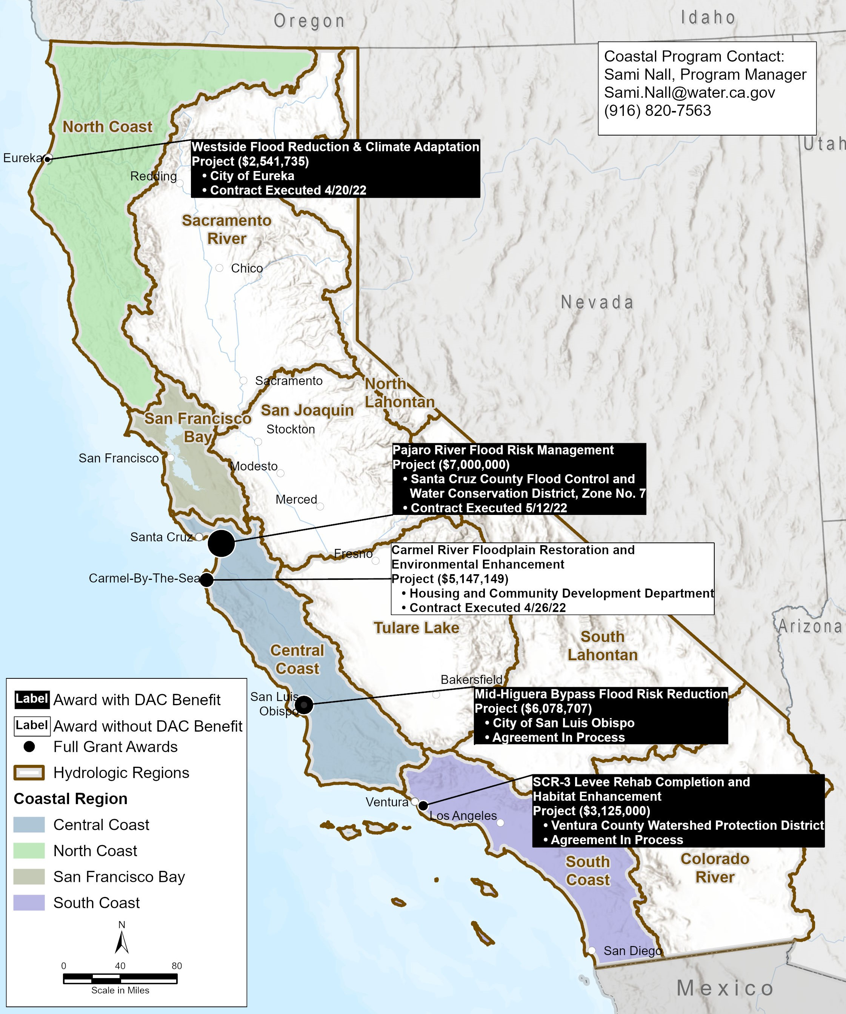
Coastal Watershed Flood Risk Reduction Program
$25.6 Million
5 Implementation Projects

Slide 9
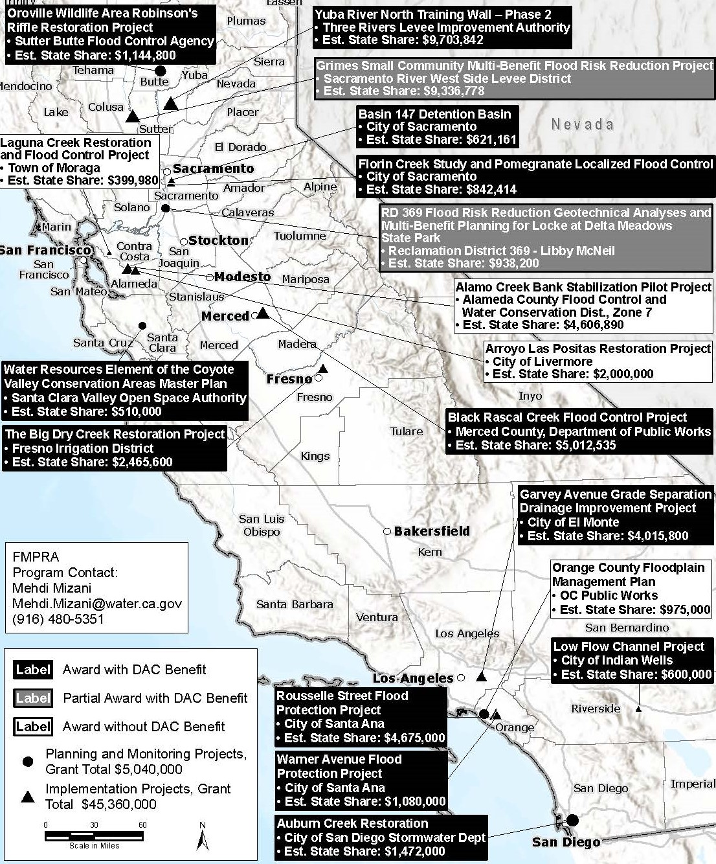
Floodplain Management Protection & Risk Awareness Program
$50 Million
13 Implementation Projects
5 Planning & Monitoring Projects

Slide 10
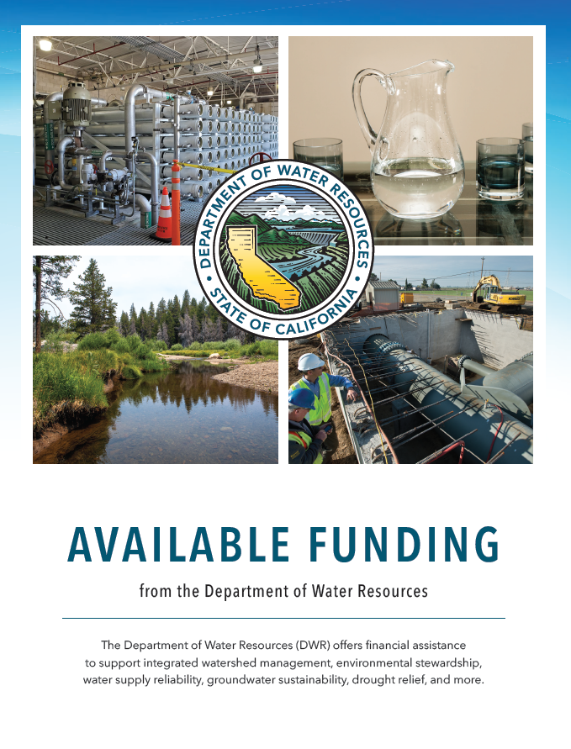
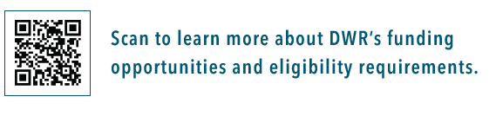
DWR Grant Pamphlet
Lists currently available or upcoming funding opportunities through DWR

Slide 11
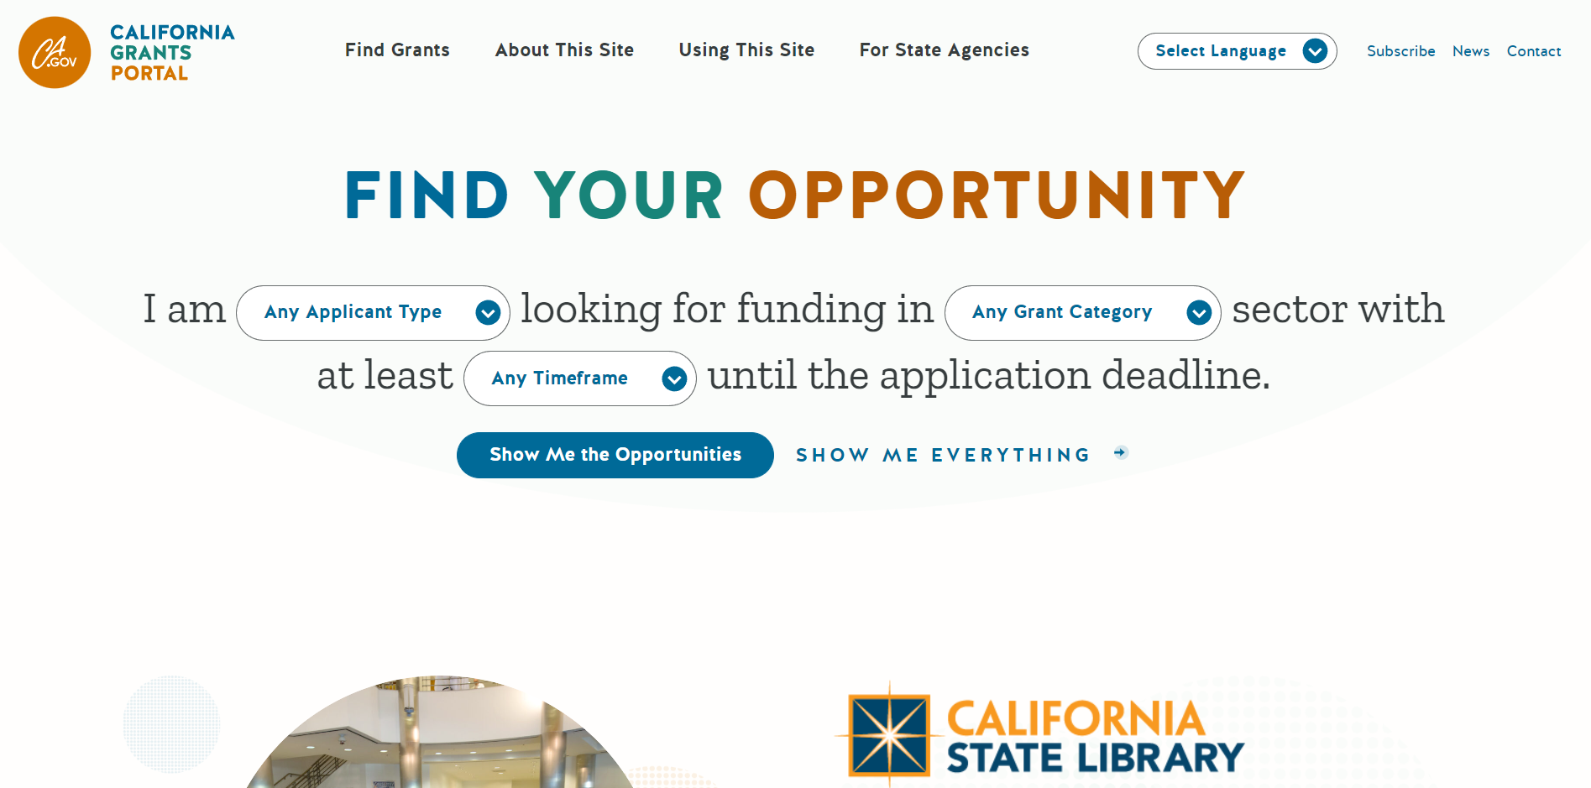
California Grants Portal
https://www.grants.ca.gov/
Control, River and Coastal Protection Bond Act of 2006
with Governor’s budget
Notes:
CA Grants Portal: www.grants.ca.gov
“The California Grants Portal is your one destination to find all grants and loans offered on a competitive or first-come basis by California state agencies.”

