Slide 1
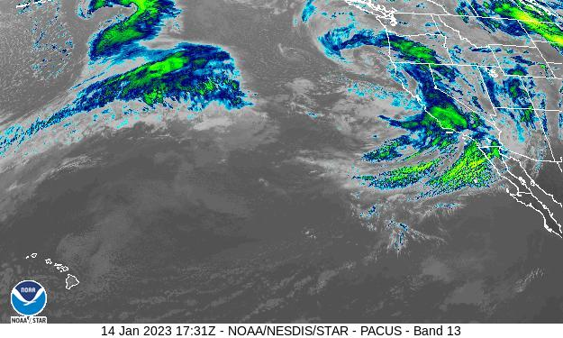
2023 Winter Storms Response
CALIFORNIA DEPARTMENT OF WATER RESOURCES
CEAC, March 8, 2023
Amy Bindra, DFM Policy Advisor

Slide 2
CALIFORNIA DEPARTMENT OF WATER RESOURCES
Outline of Today’s Topics
The Hazard aka the Storms
The Response aka the Flooding
The Consequences aka DR-4683
Mitigation Actions
Salinas River – Monterey County

Slide 3
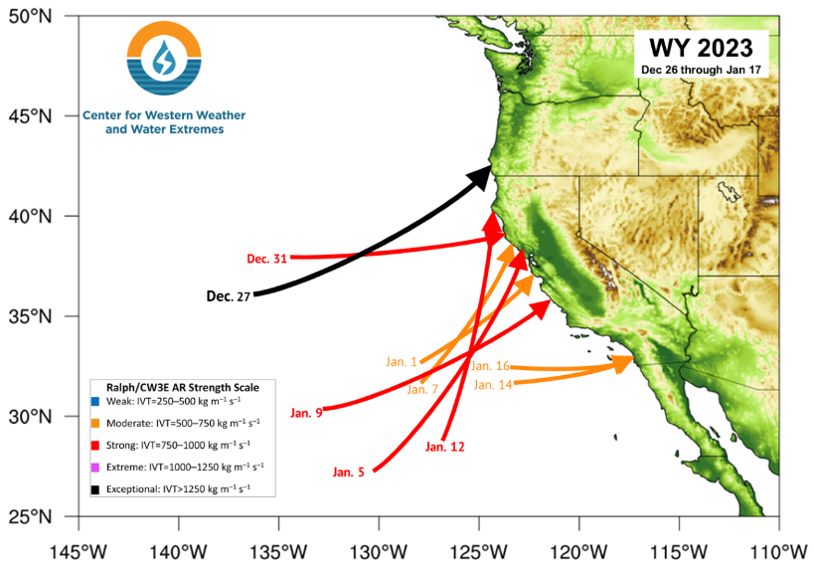
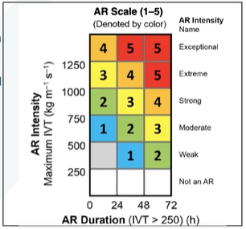
The Hazard
The Parade of Storms January 2023
9 Atmospheric Rivers in 3 weeks
1 Exceptional
4 Strong
4 Moderate
Only 3 strong ARs in WY2020 & WY 2021 combined

Slide 4
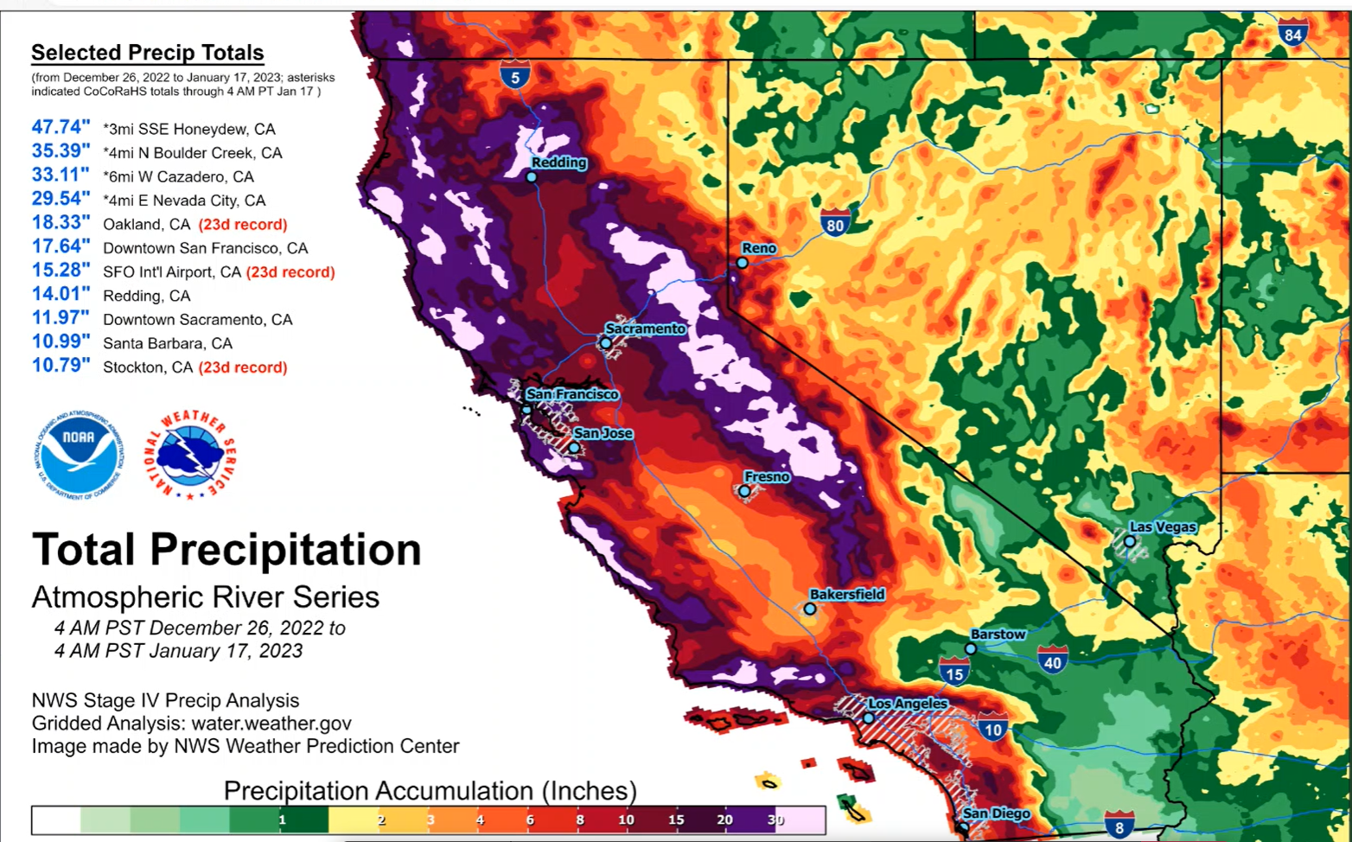
The Hazard:
Extreme 20 day Cumulative Rainfall Totals

Slide 5
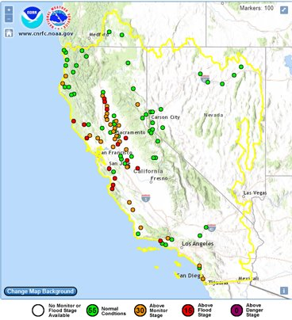
Our (Early) Response:
NWS River Forecast Locations
CA/NV only have about 100 official forecast locations on major rivers
Nearly half of these locations exceeded monitor stage over the course of the 20 days
These forecasts were used to issue advanced evacuations and preposition emergency responders aka “assets” including:
  CalTrans
  Swift Water Rescue Teams
  EMTs
  Air resources from National Guard
Cal OES State Operations Center had a full GIS / mapping team as part of the first time “Advanced Planning” was incorporated into asset management

Slide 6
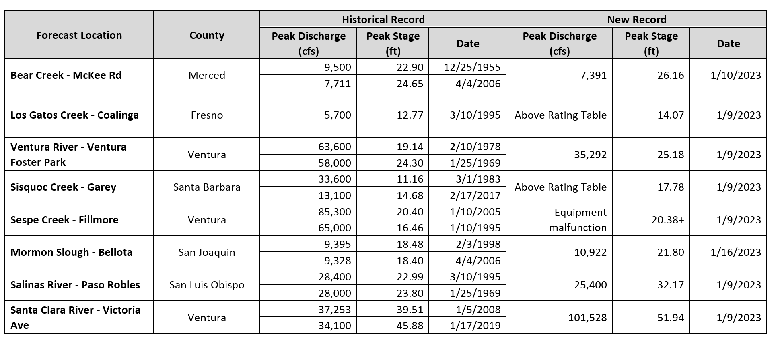
Watershed Response:
8 New Stage Records Set

Slide 7
Our Response: Mobilization
Jan. 4, 2023 – Gov. Newsom proclaimed statewide emergency, including mobilization of:
  CA National Guard, Caltrans, & other State entities
  State Operations Center (SOC) @ Cal OES
  Department Operations Center (DOC) @ DWR
  Flood Operations Center (FOC) @ DWR
  Public utilities
Federal agencies including FEMA, USCG, USGS, NOAA, NASA, USACE, USAF joined SOC
Private sector and NGOs also joined SOC including American Red Cross and ESRI
Responses based on NWS / DWR forecasts supported:
  Prepositioning of materials and people (assets)
  Road closures
  Opening shelters
  Evacuation orders
  Coordination calls
Jan. 14, 2023 – President Biden declared major disaster (DR-4683) known as California Serve Winter Storms, Flooding, Landslides, and Mudslides
Image: Cover of DRAFT Joint Hazard Mitigation Strategy for DR-4683 as required by Stafford Act of 1988

Slide 8
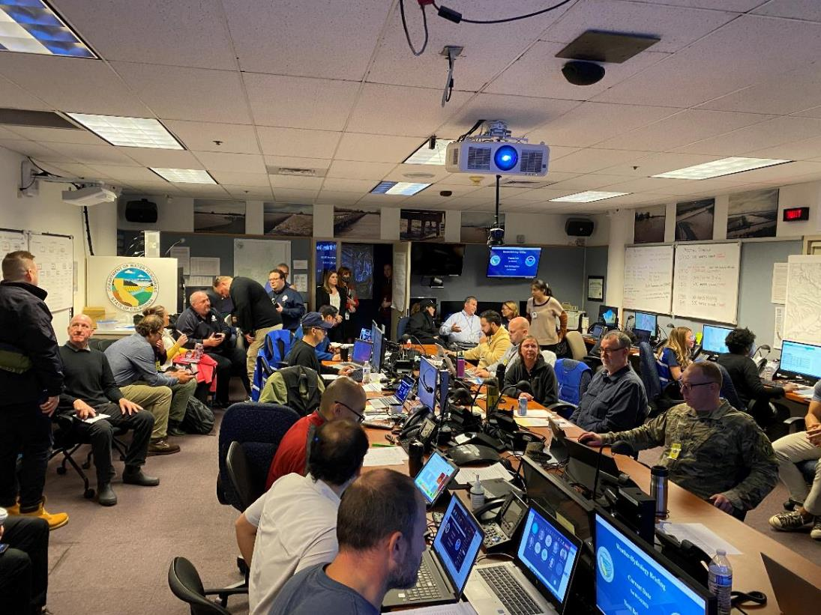
FOC Activation
FOC Activated 01/03/23 – 01/20/23
FOC – 153 activated
DOC – 67 activated
SWP – 17 activated
DSOD – 14 activated
Total – 251 staff

Slide 9
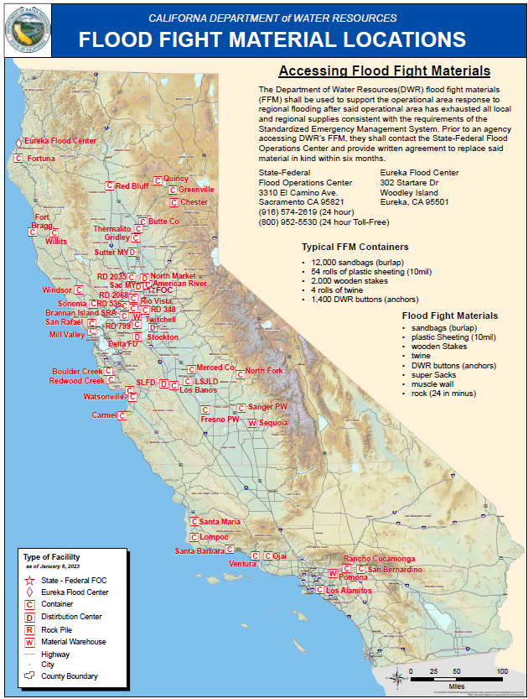
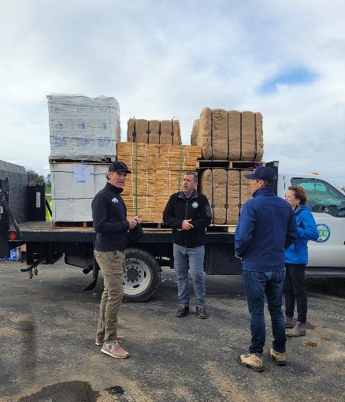
Direct Assistance
    Over 900,000 sandbags
    300 rolls of plastic sheeting
    2,000 super sacks
    3,000 linear feet of muscle wall
    9 flood fight containers
    2 DOE Construction Contracts
    9 CCC Crews Deployed
    1 ICT Deployed (Merced)

Slide 10
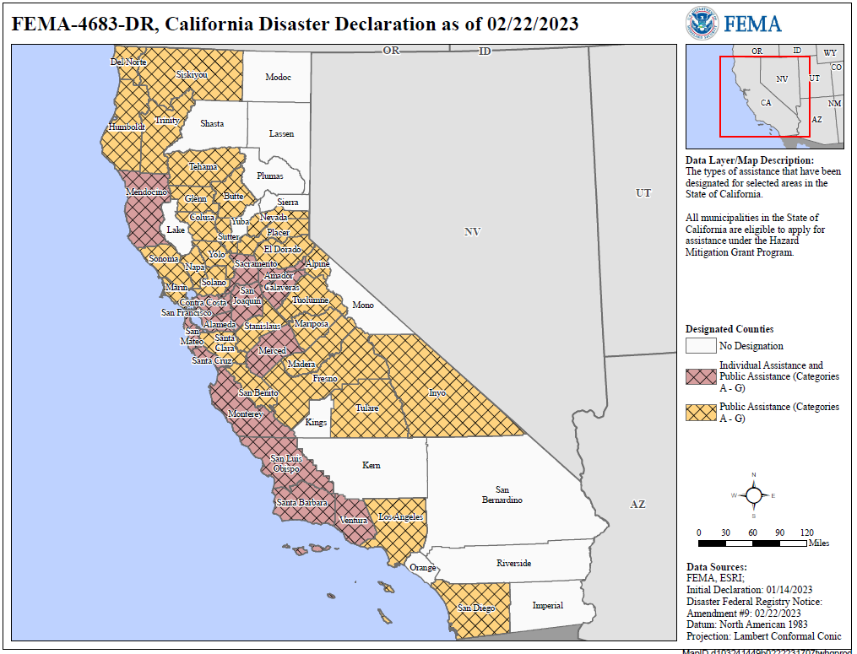
The Consequences:
Counties with IA, PA, or Both
Most of the State experienced major losses …
Individual Assistance (IA) exceeded $20M in approved claims by the end of Feb. 2022
IA includes private structure losses and temporary relocation costs (housing)
Public Assistance (PA) is being calculated
PA includes replacement costs for any public facility, including:
  Levees, floodwalls, dams
  Sediment basins, floodways / channels
  Jetties, Quays, Piers
  Roads
  Debris basins
  Treatment plants
  Public Structures and Public utilities

Slide 11
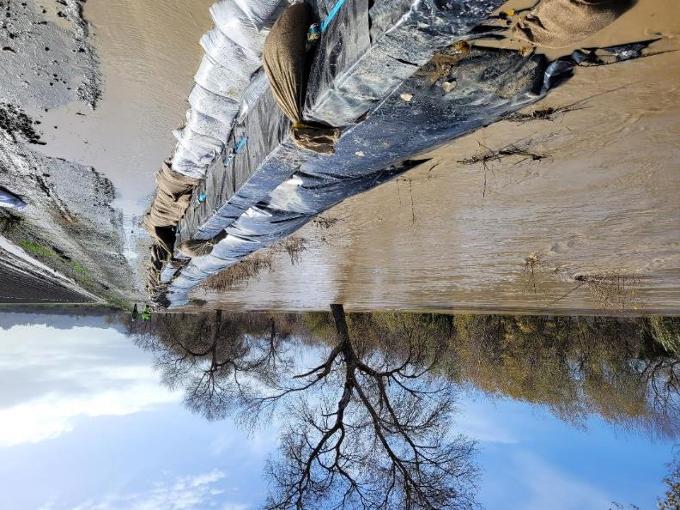
Flood Mitigation Activities
Mitigation
Land Use Regulations
Building Codes
Insurance
Early Warning systems
Training/ Exercises
Small Flood Projects
Floodproofing, Relocating, Elevating, Demolishing Structures
Response
Flood Event, Emergency Measures
Recovery
Relief - Housing requires highly specialized support services
Flood insurance is one of the quickest economic recovery mechanisms
Rehabilitation and repair can be costly, but sometimes offers new opportunities for improvements as well
Image: Pajaro River – Monterey/Santa Cruz County

Slide 12
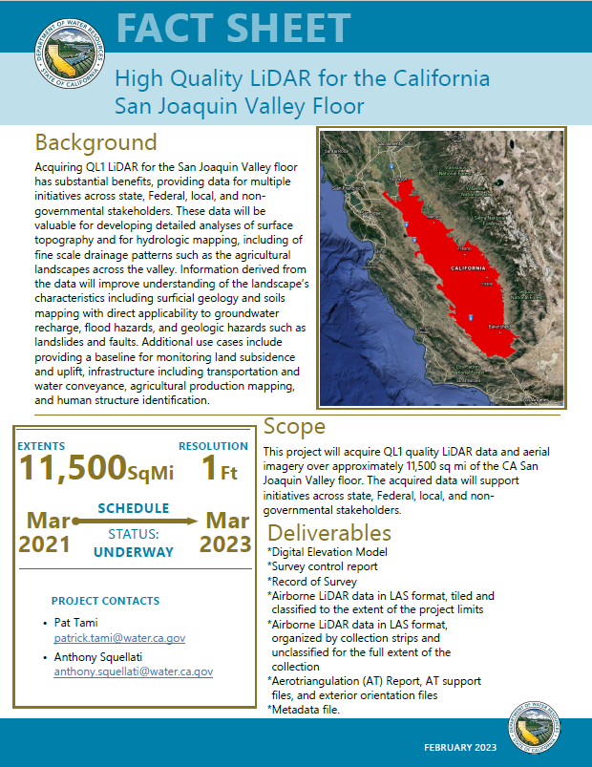
Update: LiDAR for San Joaquin Valley Floor
This project will acquire QL1 quality LiDAR data and aerial imagery over approximately 11,500 sq mi of the CA San Joaquin Valley floor.
The acquired data will support initiatives such as groundwater recharge, flood hazards, and geologic hazards such as landslides and faults across state, Federal, local, and non-governmental stakeholders.
Project started in March 2021 and is going through a QA/QC process.

Slide 13
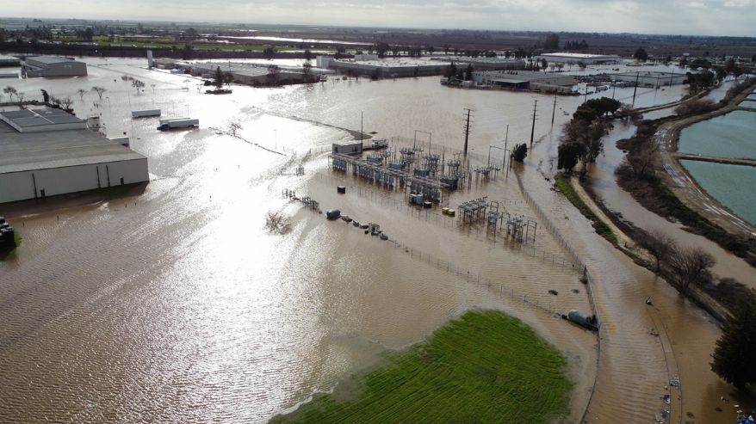
Contact Info
Amy Bindra, P.E., Policy Advisor
Amarjot.Bindra@water.ca.gov
CA Dept. Water Resources
Image: Levee break on Bear Creek in Merced (Merced County), Jan. 2023.

