Slide 1
Paying for Water: Floods
CEAC Flood Control & Water Resource Policy Committee
September 16, 2015
Caitrin Chappelle
Supported by the S.D. Bechtel, Jr. Foundation

Slide 2
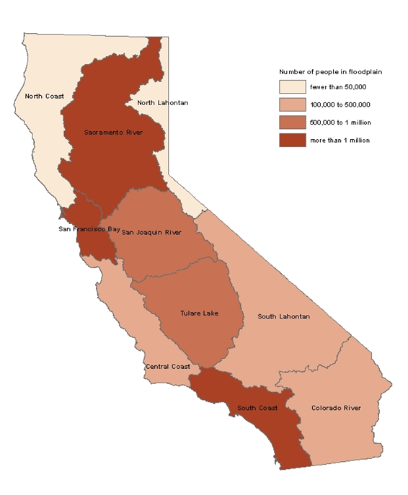
Floods are common throughout California
25% of Californians live in floodplains; 4% at extreme risk
Most flood control investments do not prevent floods, they simply reduce frequency
Notes:
Damaging floods are common throughout California.
Over the past 60 years, every county has been declared a state or federal flood disaster area multiple times.
One in five residents lives in a flood-prone area.
Four percent of all Californians live in areas that flood frequently
Another 17 percent are protected by levees and other infrastructure against a “100-year” flood—a flood with a 1 percent chance of occurring in any year. But these people remain vulnerable to larger, less frequent floods. The 100-year federal standard is generally considered insufficient for urban areas, where damages from larger floods would be quite high.
The replacement value of buildings vulnerable to floods exceeds $575 billion. Roads, airports, and other public infrastructure are also exposed.

Slide 3
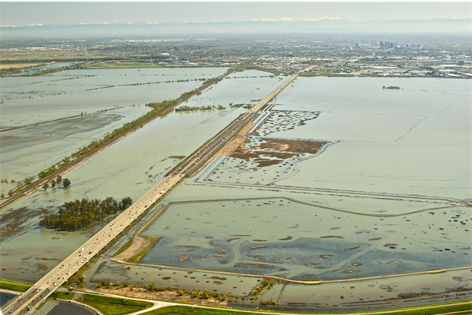
California flood management faces significant challenges
Many cities already at high risk
Complacency and lack of awareness
Very high financial and environmental costs of new infrastructure
Declining federal and state support
Floods risk increasing with climate change and population growth
Notes:
California flood management faces significant challenges.
Population growth and new development are increasing the threats to public safety and the economic risk from flooding.
There is a lack of awareness among Californians regarding their flood risk (especially during an extended drought)
The Paterno court decision in 2003 held the state liable for damages caused by failure of a locally maintained levee, exposing taxpayers to billions of dollars in potential costs.
There is a large and growing gap between flood infrastructure needs and rates of investment, with declining federal and state support
The changing climate is likely to bring larger and more frequent floods, increasing pressure on flood management systems that were designed for conditions in the early 20th century.
Finally, a rising sea level and extreme high tides are increasing flood risk in communities bordering the ocean, the San Francisco Bay, and the Delta.

Slide 4
Flood protection is a small share of the $30+ billion spent annually on CA water
$19.5
Source: Hanak et al. 2014 Paying for Water in California, PPIC, from various sources
Notes:
California spends over $30 billion annually on its water system, floods are a small portion of that.
Water supply and wastewater make up the majority of funding, they are generally able to keep up with needs because of the ability to charge ratepayers.
Saw that before this you were discussing stormwater management, the water quality category includes management of wastewater and approximately $500 million for polluted stormwater and other runoff
Flood protection: 2,152
Local: Flood management agencies:1,348
Local: Flood insurance premiums (private residents and businesses): 204
State: Flood management (DWR): 346
Federal: Flood management (USACE) : 239
Federal: Floodplain mapping (FEMA) :14

Slide 5
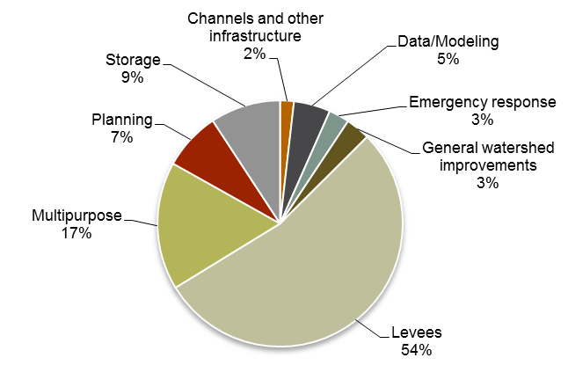
Past bond funds have gone to a variety of projects, but mainly levee improvements
Flood management bond awards by function through 2012 ($3,356 million)
Source: Paying for Water in California, PPIC 2014
Notes:
Bonds passed in the 2000s authorized almost $5 billion in flood protection funding.
While the majority of flood funding went towards levee maintenance other types of projects are beneficial.
Flood protection can be improved by setting levees back from rivers and allowing waters to spread out on undeveloped floodplains.
Such an approach also boosts habitat, as the Yolo Bypass near Sacramento shows.
Better fire management in upstream forests can diminish peak flood flows and mudslides.
Retaining more urban stormwater—by using rain gardens, for example—can reduce nuisance flooding, improve surface water quality, and recharge groundwater basins.
These type of multi-benefit projects can be challenging to fund and permit.

Slide 6
Despite boost from recent GO bonds, flood investments are seriously lagging
Annual gap: $800M - $1B
Prop 218 voting requirements hinder local fundraising
Decline in federal and state support
Source: DWR & USACE, Flood Futures, 2013 (need)
Notes:
A recent state study put the cost of upgrading levees and other defenses at more than $34 billion, leaving an annual funding gap of $800 million to $1 billion for making these investments within a 25-year time frame. Because federal and state funds are limited, the funding burden will increasingly fall on localities.
Local taxes and fees currently fund most maintenance but pay for less than half of infrastructure investments.
On average, filling the gap would require roughly doubling local spending.

Slide 7
Flood funding gap highest in the Central Valley
Source: Paying for Water in California, PPIC 2014
Notes:
This may not seem large, on average: In 2011, Californians spent $31 per, and it would cost another $30 per person per year to fill this gap
This would be significantly more in some areas of California, especially the Central Valley.
Costs to local residents could vary widely, depending on whether the flood funding gap were paid for with local fees and taxes or state general fund taxes
To see this, compare the middle bars showing additional costs to regional residents if the gap is funded with local taxes and fees to the bottom bars showing additional costs to residents if the gap is instead paid for by state general fund taxes.
If only local funding is available, additional per capita costs would be especially high in the Sacramento and San Joaquin River regions, which together account for half of the total estimated needs.
If state general fund taxes are available, residents in coastal areas, and especially the San Francisco Bay Area, would pay a much higher share of the costs because the state’s general fund relies heavily on progressive income taxes, and incomes are generally higher in the coastal regions.

Slide 8
California must go beyond bonds to close funding gaps
Gap area | Annual gap ($ millions) | One-time infusion from Prop 1 ($ millions) | Other long-term funding options
Safe drinking water in small rural systems | $30–$160 | $260* | Statewide surcharges on water, chemical use
Flood protection | $800–$1,000 | $395 | Developer fees Property assessments Special state, local taxes
Stormwater management | $500–$800 | $200 | Developer fees Property assessments Special state, local taxes Surcharges on water, chemical, or road use
Aquatic ecosystem management | $400–$700 | $2,845** | Special state, local taxes Surcharges on water use, hydropower production
Integrated management | $200–$300 | $510 | Special state, local taxes Surcharges on water use
*These funds are available for communities of all sizes. Another $260 million is available for small community wastewater systems.
** This includes the $1.495 billion earmarked for ecosystem investments and $1.35 billion from water storage project matching funds set aside for ecosystem benefits.
Notes:
Since 2000, state bonds have helped fund all five gap areas, and Proposition 1 extends some of that support. But bonds are not a reliable long-term funding source.
To address funding gaps we need to find a way to expand local funding tools. Local flood management agencies need more ways to raise funds, and this may require reforming Prop 218 to treat flood agencies like water and sewer utilities—that is, by requiring transparent accounting but allowing elected governing boards to raise fees.
Increase incentives to carry flood insurance. To help manage risk, California should expand flood insurance use. One novel
approach would give local or regional flood management agencies authority to buy insurance for the community. Pooling resources
this way would increase coverage and cut costs. The legislature could encourage this by creating mechanisms to recover costs
through assessments or fees.
Build on Central Valley reforms. In 2007, California enacted a package of flood management reforms for the Central Valley,
including higher protection standards, greater risk-reduction responsibility for communities, new planning tools, and incorporation
of ecosystem objectives and climate change. Many of these reforms should be adopted in other flood-prone regions of the state.
Prioritize state funding. Since 2006, the state has used bonds to finance flood projects. Proposition 1, approved in November
2014, earmarks an additional $595 million for flood and stormwater management. It is critical that the state set investment priorities
with its limited resources. State funding is especially useful to support projects that take integrated approaches to water management,
benefiting water supply, water quality, ecosystems, and open space—in addition to flood protection.

Slide 9
Thank you!
These slides were created to accompany a presentation.
They do not include full documentation of sources, data samples, methods, and interpretations. To avoid misinterpretations, please contact:
Your name (chappelle@ppic.org; 415-291-4435)
Thank you for your interest in this work.

